Slide 1
Sorting Algorithms

Slide 2
Rearranging the elements of a list in ascending or descending order is called sorting.
Sorting algorithms are based on comparing values or some may be based on analyzing properties of values.
For example, if you know that your list only holds values from 0 to 9, you can just count how many of each in one sweep (O(n)) and construct the sorted list.

Slide 3
Examples of sorting applications:
a directory of files sorted by name or date
bank checks sorted by account #
addresses in a mailing list sorted by zip code
hits found by a search engine sorted by relevance
credit card transactions sorted by date

Slide 4
Sorting
O(n²)
By counting
Selection Sort
Insertion Sort
O(n log n)
Mergesort
Quicksort
Heapsort
Notes:
‹#›

Slide 5
Sorting Categories
Sorting by Insertion insertion sort, shellsort
Sorting by Exchange bubble sort, quicksort
Sorting by Selection selection sort, heapsort
Sorting by Merging merge sort
Sorting by Distribution radix sort
Notes:
‹#›

Slide 6
Sorting by Counting — O(n²)
For each value in the list, count how many values are smaller (or equal with a smaller index).
Place that value into the position indicated by the count.
for (int i = 0; i < n; i++)
{
count = 0;
for (int j = 0; j < n; j++)
if (a [ j ] < a [ i ] | | (a [ j ] == a [ i ] && j < i ) )
count++;
b [count ] = a [ i ];
}
Always n² comparisons
Notes:
‹#›
This method is mentioned just for completeness. Even Selection Sort is better.

Slide 7
Insertion Sort

Slide 8
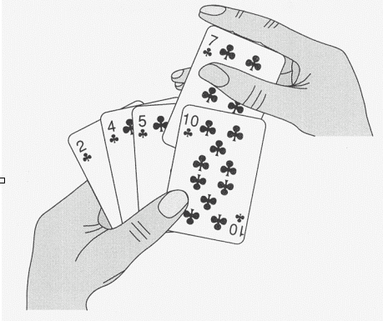
Insertion Sort
Insertion Sort orders a list in the same way we would order a hand of playing cards.

Slide 9
Insertion Sort
Insertion Sort orders a list in the same way we would order a hand of playing cards.
Compare the first two numbers, placing the smallest one in the first position.
Compare the third number to the second number. If the third number is larger, then the first three numbers are in order. If not, then swap them. Now compare the numbers in positions one and two and swap them if necessary.
Proceed in this manner until reaching the end of the list.

Slide 10
Inserting a Value
1. Find the right place to insert:
2. Shift elements to the right,
starting from the last one:
3. Insert the value in its proper place:
Can be combined together
5
1
1
2
3
8
13
5
1
1
2
3
8
13
1
1
2
3
5
8
13
Notes:
‹#›

Slide 11
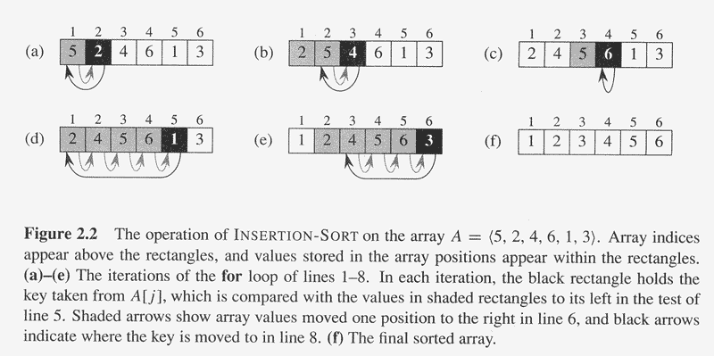

Slide 12
Analysis of Insertion Sort
Maximum number of comparisons is O(n*n).
In the best case, number of comparisons is O(n).
The number of shifts performed during an insertion is one less than the number of comparisons or, when the new value is the smallest so far, the same as the number of comparisons.
A shift in an insertion sort requires the movement of only one item whereas in a bubble or selection sort an exchange involves a temporary item and requires the movement of three items.

Slide 13
Analysis
In best case, input is sorted: time is O(N)
In worst case, input is reverse sorted: time is O(N²).
Average case is (loose argument) is O(N²)

Slide 14
public void insertionsort(int[] data)
{ int tmp,i,j;
for(i=1; i<data.length; i++)
{ tmp=data[i];
for(j=i; j>0 && tmp<data[j-1]; j--)
data[j] = data[j-1];
data[j] =tmp;
}
}

Slide 15
Selection Sort

Slide 16
Selection Sort Algorithm
List is sorted by selecting list element and moving it to its proper position
Algorithm finds position of smallest element and moves it to top of unsorted portion of list
Repeats process above until entire list is sorted

Slide 17



Sorting an Array of Integers
Find the smallest and swap it with the first element
Find the next smallest. It is already in the correct place
Find the next smallest and swap it with first element of unsorted portion
Continued…….

Slide 18


Sorting an Array of Integers
Repeat
When the unsorted portion is of length 1, we are done

Slide 19
Selection Sort
public void selectionsort(object[] data)
{ int i,j,least;
for(i=0; i<data.length-1; i++)
for(j=i+1, least=i; j<data.length; j++)
if((Comparable)data[j].compareTo(data[least])<0)
least=j;
swap(data,least,i); }}

Slide 20
void swap(object[] a, int e1, int e2)
{
object tmp=a[e1];
a[e1]= a[e2];
a[e2]=tmp;
}

Slide 21
Analyzing Selection Sort
We will assume that the computer spends time only on comparisons and swaps. However, since the average number of swaps is extremely difficult to compute, we will focus only on comparisons.
On a list of size 4, we would compare the first position to the other 3 numbers, the second position to the 2 remaining numbers, and the third position to the 1 remaining number. This is a total of 3+2+1 = 6 comparisons.
So, for a list of size n, there will be n-1 + n-2 + … + 2 + 1 comparisons. In other words, (n-1)(n/2) comparisons.
Notes:
‹#›

Slide 22
Selection Sort
Selection sort is called a quadratic sort
Number of comparisons is O(n*n)
Number of exchanges is O(n)

Slide 23
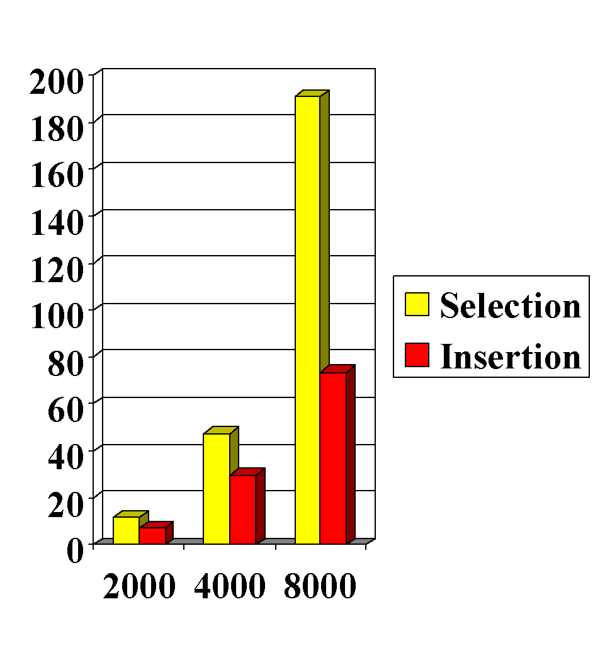
Selection Sort vs. Insertion Sort (Time in Seconds on a 386 microprocessor running at 20 mHz).
Insertion Sort is about twice as fast as Selection Sort.
But note that as the list size doubles, the time for both sorts increases about four-fold.

Slide 24
Bubble Sort

Slide 25
Bubble Sort
Compares adjacent array elements
Exchanges their values if they are out of order
Smaller values bubble up to the top of the array
Larger values sink to the bottom

Slide 26
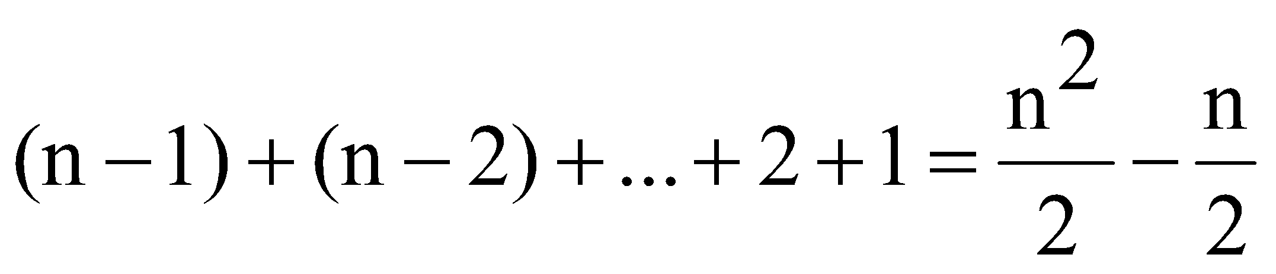
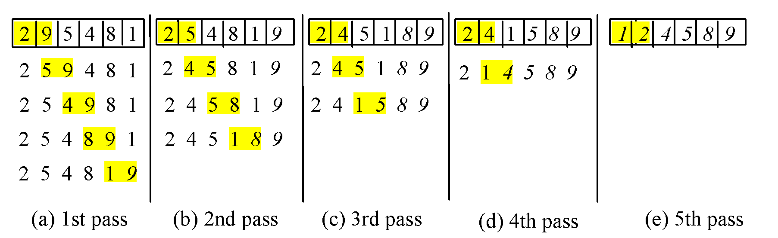
Bubble Sort
Bubble sort time: O(n²)
Notes:
‹#›

Slide 27
public void bubblesort(Object[] data)
{
int i,j;
for(i=0; i<data.length-1; i++)
for(j=data.length-1; j>i; --j)
if(((Comparable)data[j]).compareTo(data[j-1]) < 0)
swap(data,j,j-1);
}

Slide 28
Analysis of Bubble Sort
Works best when array is nearly sorted to begin with.
Worst case number of comparisons is O(n*n)
Worst case number of exchanges is O(n*n)
Best case occurs when the array is already sorted
O(n) comparisons
O(1) exchanges

Slide 29
Shell Sort

Slide 30
The idea of Shellsort is the following:
arrange the data sequence in a two-dimensional array
sort the columns of the array
The effect is that the data sequence is partially sorted.
Shellsort improves on the efficiency of insertion sort by quickly shifting values to their destination.

Slide 31
Shellsort works by comparing elements that are distant rather than adjacent elements in an array or list where adjacent elements are compared.
Shellsort makes multiple passes through a list and sorts a number of equally sized sets using the insertion sort.

Slide 32
In each step, the sortedness of the sequence is increased, until in the last step it is completely sorted.
However, the number of sorting operations necessary in each step is limited, due to the pre sortedness of the sequence obtained in the preceding steps.

Slide 33
Shellsort Examples
Sort: 18 32 12 5 38 33 16 2
8 Numbers to be sorted, Shell’s increment will be floor(n/2)
* floor(8/2) 🡺 floor(4) = 4
increment 4:
1 2 3 4
(visualize underlining)
18 32 12 5 38 33 16 2
Step 1) Only look at 18 and 38 and sort in order ;
18 and 38 stays at its current position because they are in order.
Step 2) Only look at 32 and 33 and sort in order ;
32 and 33 stays at its current position because they are in order.
Step 3) Only look at 12 and 16 and sort in order ;
12 and 16 stays at its current position because they are in order.
Step 4) Only look at 5 and 2 and sort in order ;
2 and 5 need to be switched to be in order.

Slide 34
Shellsort Examples
Sort: 18 32 12 5 38 33 16 2
Resulting numbers after increment 4 pass:
18 32 12 2 38 33 16 5
* floor(4/2) 🡺 floor(2) = 2
increment 2:
1 2
18 32 12 2 38 33 16 5
Step 1) Look at 18, 12, 38, 16 and sort them in their appropriate location:
12 38 16 2 18 33 38 5
Step 2) Look at 32, 2, 33, 5 and sort them in their appropriate location:
12 2 16 5 18 32 38 33

Slide 35
Shellsort Examples
Sort: 18 32 12 5 38 33 16 2
* floor(2/2) 🡺 floor(1) = 1
increment 1:
1
12 2 16 5 18 32 38 33
2 5 12 16 18 32 33 38
The last increment or phase of Shellsort is basically an Insertion
Sort algorithm.

Slide 36

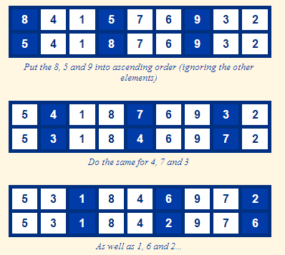

Slide 37
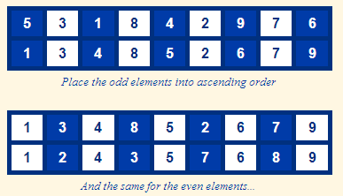
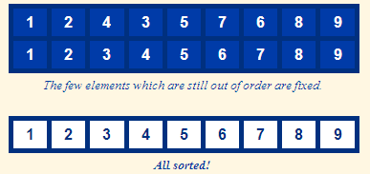

Slide 38
Best Case: The best case in the shell sort is when the array is already sorted in the right order. The number of comparisons is less.
The running time of Shellsort depends on the choice of increment sequence.
The problem with Shell’s increments is that pairs of increments are not necessarily relatively prime and smaller increments can have little effect.

Slide 39
Analysis of Shell Sort
A general analysis of Shell sort is an open research problem in computer science
Performance depends on how the decreasing sequence of values for gap is chosen
If successive powers of two are used for gap, performance is O(n*n)
If Hibbard’s sequence is used, performance is O(n^(3/2))

Slide 40
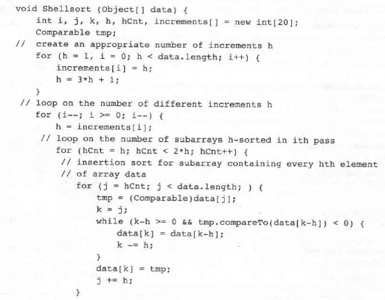

Slide 41
ShellSort
O(n^{3/2}) sorting
template <class Comparable>
void shellsort( vector<comparable> &a );
{
for ( int gap = a.size( ) / 2; gap > 0; gap = ( gap == 2 )? 1 : int( gap / 2.2 ) ) {
for ( int i = gap; i < a.size( ); i++ ) {
Comparable tmp = a[i];
int j = i;
for ( ; j >= gap && tmp < a[j – gap]; j -= gap )
a[j] = a[j – gap];
a[j] = tmp;
}
}
}
(1)
(3)
(2)
(4)
(5)
(2)
Assume i = a.size( ) –1
gap = 16/2 = 8
(1)
0
16
81
94
11
96
12
35
17
95
28
58
41
75
15
85
87
38
20
(4)
(4)
Shift a[16-8 * 2] if it is larger than tmp
Shift a[16-8] if it is larger than tmp
(5)
20
(3)
tmp

Slide 42
Merge Sort

Slide 43
Merge Sort: Idea
Divide into
two halves
A
FirstPart
SecondPart
Recursively sort
FirstPart
SecondPart
Merge
A is sorted!
Notes:
‹#›

Slide 44
Merge Sort
Divide: divide the n-element sequence to be sorted into two subsequences of n/2 elements each
Conquer: sort the two subsequences recursively using merge sort
Combine: merge the two sorted subsequences to produce the sorted answer
Notes:
‹#›

Slide 45
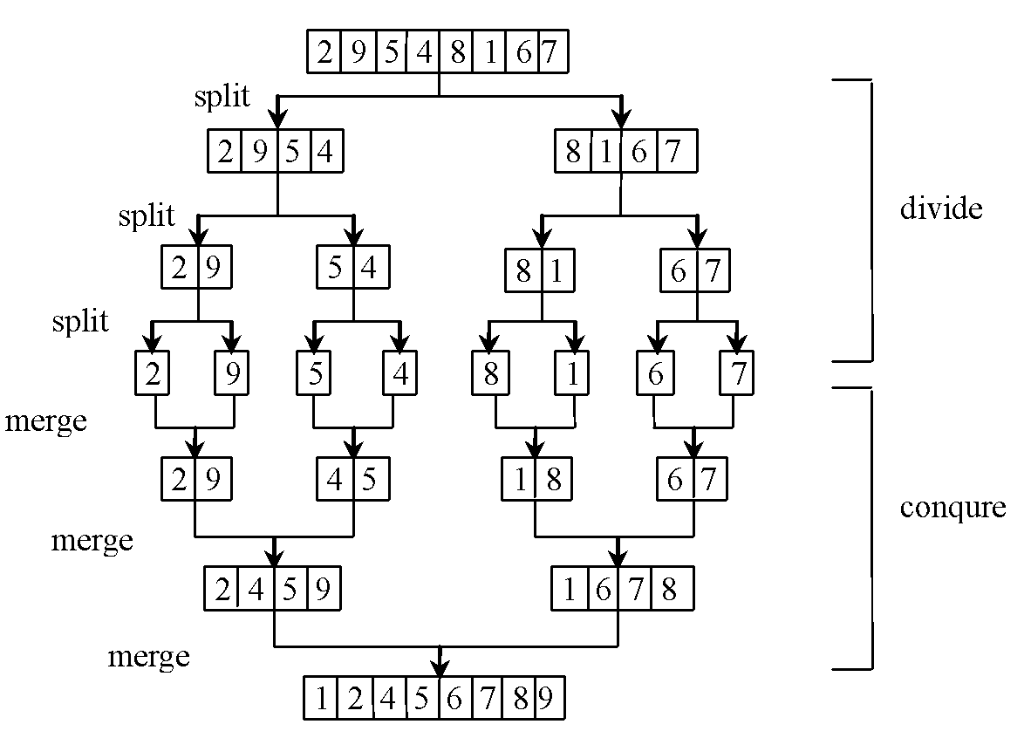
Merge Sort

Slide 46
Merge Algorithm
Merge Algorithm
Access the first item from both sequences
While not finished with either sequence
Compare the current items from the two sequences, copy the smaller current item to the output sequence, and access the next item from the input sequence whose item was copied
Copy any remaining items from the first sequence to the output sequence
Copy any remaining items from the second sequence to the output sequence

Slide 47
Mergesort
1. Split the array into two roughly equal “halves.”
2. Sort (recursively) each half using Mergesort.
3. Merge the two halves together
5
1
3
2
4
7
6
1
3
5
2
4
6
7
1
3
5
1
2
3
2
4
6
7
The smaller one goes first
Notes:
‹#›

Slide 48
Mergesort
public void mergesort ( double arr [ ],
int from, int to )
{
if (from <= to)
return;
int middle = (from + to ) / 2;
mergesort (arr, from, middle);
mergesort (arr, middle + 1, to);
if (arr [middle] > arr [middle+ 1] )
{
copy (arr, from, to, temp) ;
merge (temp, from, middle, to, arr);
}
}
Optional shortcut: “if not yet sorted”...
double temp[ ] is initialized outside the mergesort method
Notes:
‹#›

Slide 49
Merge-Sort: Merge
Sorted
A:
merge
Sorted FirstPart
Sorted SecondPart
A:
A[left]
A[middle]
A[right]
Notes:
‹#›

Slide 50
Merge-Sort: Merge Example
A:
2
3
7
8
1
4
5
6
5
5
15
28
30
6
10
14
L:
R:
3
5
15
28
6
10
14
22
Temporary Arrays
Notes:
‹#›

Slide 51
Merge-Sort: Merge Example
A:
3
1
5
15
28
30
6
10
14
k=0
L:
R:
3
2
15
3
28
7
30
8
6
1
10
4
14
5
22
6
i=0
j=0
Notes:
‹#›

Slide 52
Merge-Sort: Merge Example
A:
1
2
5
15
28
30
6
10
14
k=1
L:
R:
3
2
5
3
15
7
28
8
6
1
10
4
14
5
22
6
i=0
j=1
Notes:
‹#›

Slide 53
Merge-Sort: Merge Example
A:
1
2
3
15
28
30
6
10
14
k=2
L:
R:
2
3
7
8
6
1
10
4
14
5
22
6
i=1
j=1
Notes:
‹#›

Slide 54
Merge-Sort: Merge Example
A:
1
2
3
4
6
10
14
k=3
L:
R:
2
3
7
8
6
1
10
4
14
5
22
6
i=2
j=1
Notes:
‹#›

Slide 55
Merge-Sort: Merge Example
A:
1
2
3
4
5
6
10
14
k=4
L:
R:
2
3
7
8
6
1
10
4
14
5
22
6
i=2
j=2
Notes:
‹#›

Slide 56
Merge-Sort: Merge Example
A:
1
2
3
4
5
6
6
10
14
k=5
L:
R:
2
3
7
8
6
1
10
4
14
5
22
6
i=2
j=3
Notes:
‹#›

Slide 57
Merge-Sort: Merge Example
A:
1
2
3
4
5
6
7
14
k=6
L:
R:
2
3
7
8
6
1
10
4
14
5
22
6
i=2
j=4
Notes:
‹#›

Slide 58
Merge-Sort: Merge Example
A:
1
2
3
4
5
6
7
8
14
k=7
L:
R:
3
2
5
3
15
7
28
8
6
1
10
4
14
5
22
6
i=3
j=4
Notes:
‹#›

Slide 59
Merge-Sort: Merge Example
A:
1
2
3
4
5
6
7
8
k=8
L:
R:
3
2
5
3
15
7
28
8
6
1
10
4
14
5
22
6
i=4
j=4
Notes:
‹#›

Slide 60
Merge-Sort(A, 0, 7)
Divide
A:
6 2 8 4
3 7 5 1
6 2 8 4 3 7 5 1

Slide 61
Merge-Sort(A, 0, 7)
Merge-Sort(A, 0, 3)
, divide
A:
3 7 5 1
6 2
8 4
6 2 8 4

Slide 62
Merge-Sort(A, 0, 7)
Merge-Sort(A, 0, 1)
, divide
A:
3 7 5 1
8 4
6
2
6 2

Slide 63
Merge-Sort(A, 0, 7)
Merge-Sort(A, 0, 0)
, base case
A:
3 7 5 1
8 4
2
6

Slide 64
Merge-Sort(A, 0, 7)
Merge-Sort(A, 0, 0), return
A:
3 7 5 1
8 4
6
2

Slide 65
Merge-Sort(A, 0, 7)
Merge-Sort(A, 1, 1)
, base case
A:
3 7 5 1
8 4
6
2

Slide 66
Merge-Sort(A, 0, 7)
Merge-Sort(A, 1, 1), return
A:
3 7 5 1
8 4
6
2

Slide 67
Merge-Sort(A, 0, 7)
Merge(A, 0, 0, 1)
A:
3 7 5 1
8 4
2 6

Slide 68
Merge-Sort(A, 0, 7)
Merge-Sort(A, 0, 1), return
A:
3 7 5 1
2 6
8 4

Slide 69
Merge-Sort(A, 0, 7)
Merge-Sort(A, 2, 3)
, divide
A:
3 7 5 1
2 6
8
4
8 4

Slide 70
Merge-Sort(A, 0, 7)
Merge-Sort(A, 2, 2), base case
A:
3 7 5 1
2 6
4
8

Slide 71
Merge-Sort(A, 0, 7)
Merge-Sort(A, 2, 2), return
A:
3 7 5 1
2 6
8
4

Slide 72
Merge-Sort(A, 0, 7)
Merge-Sort(A, 3, 3), base case
A:
2 6
8
4

Slide 73
Merge-Sort(A, 0, 7)
Merge-Sort(A, 3, 3), return
A:
3 7 5 1
2 6
8
4

Slide 74
Merge-Sort(A, 0, 7)
Merge(A, 2, 2, 3)
A:
3 7 5 1
2 6
4 8

Slide 75
Merge-Sort(A, 0, 7)
Merge-Sort(A, 2, 3), return
A:
3 7 5 1
2 6
4 8

Slide 76
Merge-Sort(A, 0, 7)
Merge(A, 0, 1, 3)
A:
3 7 5 1
2 4 6 8

Slide 77
Merge-Sort(A, 0, 7)
Merge-Sort(A, 0, 3), return
A:
2 4 6 8
3 7 5 1

Slide 78
Merge-Sort(A, 0, 7)
Merge-Sort(A, 4, 7)
A:
2 4 6 8
3 7 5 1

Slide 79
Merge-Sort(A, 0, 7)
Merge (A, 4, 5, 7)
A:
2 4 6 8
1 3 5 7

Slide 80
Merge-Sort(A, 0, 7)
Merge-Sort(A, 4, 7), return
A:
2 4 6 8
1 3 5 7

Slide 81
Merge-Sort(A, 0, 7)
Merge-Sort(A, 0, 7), done!
Merge(A, 0, 3, 7)
A:
1 2 3 4 5 6 7 8

Slide 82
Quick Sort

Slide 83
Quick Sort
Quick sort, developed by C. A. R. Hoare (1962), works as follows: The algorithm selects an element, called the pivot, in the array.
Divide the array into two parts such that all the elements in the first part are less than or equal to the pivot and all the elements in the second part are greater than the pivot.
Recursively apply the quick sort algorithm to the first part and then the second part.

Slide 84
Quicksort
Choose an element out of the list as a pivot. A good process to select a pivot is to compare the first, middle, and last elements and choose the middle value.
Compare every other element in the list to the pivot and create two lists, one list where every element is smaller than the pivot and one where every element is larger.
Now split each of these lists into smaller lists.
Continue in this way until the small lists have only one or two elements and we can sort them with at most one comparison each.

Slide 85
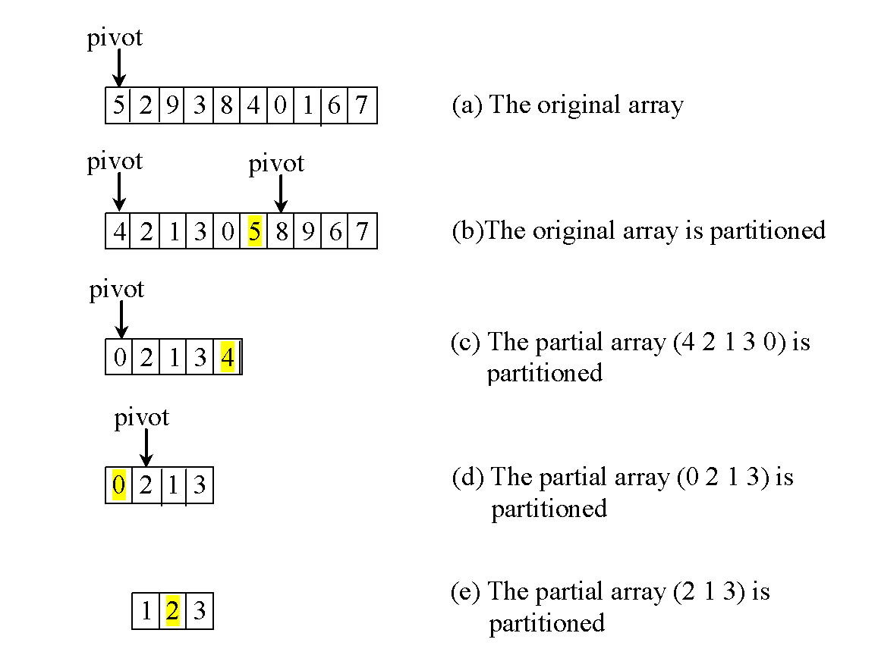
Quick Sort

Slide 86
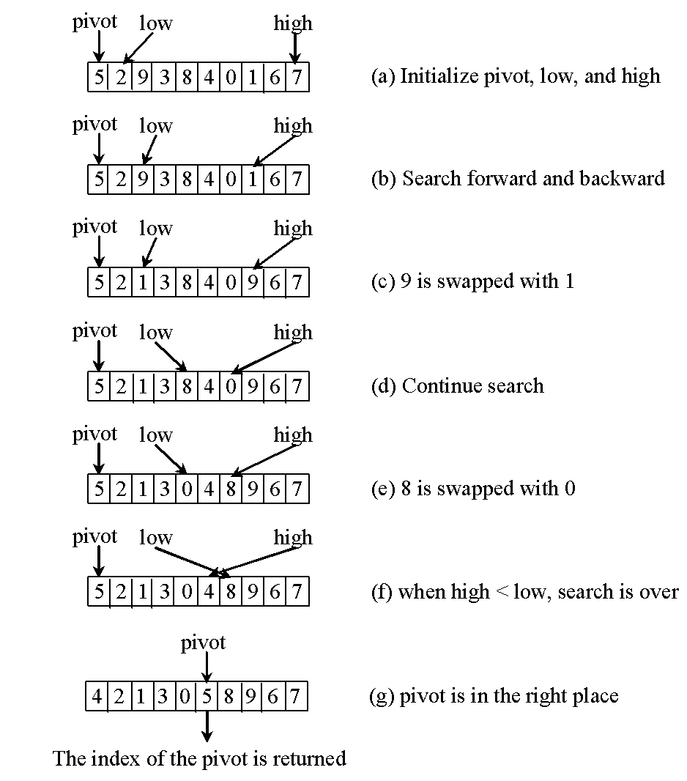
Partition

Slide 87
Quicksort
Quicksort is (in some sense) the fastest sorting algorithm known
From an array of numbers, pick one to use as a pivot
45 3 17 48 72 25 8 99 14 9 12 21 81 64 33 12 (we’ll use 45 as the pivot)
Partition the numbers into those smaller than or equal to the pivot, and those larger than the pivot
3 17 25 8 14 9 12 21 33 12 45 48 72 99 81 64
Now quicksort the left side:
And the right side:
3 8 9 12 12 14 17 21 25 33
45
48 64 72 81 99
Notes:
‹#›

Slide 88
The partition method
static int partition(int[] a, int left, int right) {
int p = a[left], l = left + 1, r = right;
while (l < r) {
while (l < right && a[l] < p) l++;
while (r > left && a[r] >= p) r--;
if (l < r) {
int temp = a[l]; a[l] = a[r]; a[r] = temp;
}
}
a[left] = a[r];
a[r] = p;
return r;
}

Slide 89
The quicksort method
static void quicksort(int[] array, int left, int right) { if (left < right) { int p = partition(array, left, right); quicksort(array, left, p - 1); quicksort(array, p + 1, right); } }

Slide 90
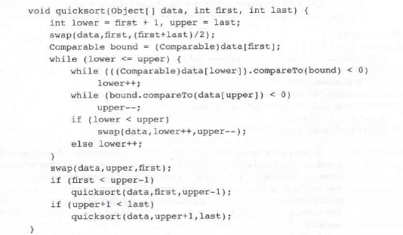

Slide 91
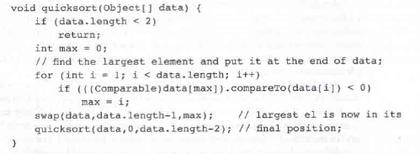

Slide 92
Quick Sort
A:
p
pivot
Partition
FirstPart
SecondPart
x < p
p
p ≤ x
Recursive call
Sorted
FirstPart
Sorted
SecondPart
x < p
p
p ≤ x
Sorted
Notes:
‹#›

Slide 93
Partition
A:
p
A:
p
x < p
p ≤ x
A:
p
x < p
p
p ≤ x
Notes:
‹#›

Slide 94
Partition Example
A:
4
8
6
3
5
1
7
2
Notes:
‹#›

Slide 95
Partition Example
i=0
A:
4
8
6
3
5
1
7
2
j=1
Notes:
‹#›

Slide 96
Partition Example
i=0
A:
4
8
6
3
5
1
7
2
8
j=1
Notes:
‹#›

Slide 97
Partition Example
i=0
A:
4
8
6
6
3
5
1
7
2
j=2
Notes:
‹#›

Slide 98
Partition Example
i=1
i=0
A:
4
8
6
3
5
1
7
2
3
3
8
j=3
Notes:
‹#›

Slide 99
Partition Example
i=1
A:
4
3
6
8
5
1
7
2
5
j=4
Notes:
‹#›

Slide 100
Partition Example
i=1
A:
4
3
6
8
5
1
1
7
2
j=5
Notes:
‹#›

Slide 101
Partition Example
i=2
A:
4
3
1
6
6
8
5
1
7
2
j=5
Notes:
‹#›

Slide 102
Partition Example
i=2
A:
4
3
1
8
5
6
7
7
2
j=6
Notes:
‹#›

Slide 103
Partition Example
i=3
i=2
A:
8
4
3
1
2
2
8
5
6
7
2
j=7
Notes:
‹#›

Slide 104
Partition Example
i=3
A:
4
3
1
2
5
6
7
8
j=8
Notes:
‹#›

Slide 105
Partition Example
i=3
A:
4
3
1
4
2
2
5
6
7
8
Notes:
‹#›

Slide 106
Partition Example
pivot in
correct position
A:
2
3
1
4
5
6
7
8
x < 4
4 ≤ x
Notes:
‹#›

Slide 107
Quick-Sort(A, 0, 7)
Partition
A:
2 3 1
4
4 8 6 3 5 1 7 2
5 6 7 8

Slide 108
Quick-Sort(A, 0, 7)
Quick-Sort(A, 0, 2)
, partition
A:
4
5 6 7 8
1
3
2 3 1
2

Slide 109
Quick-Sort(A, 0, 7)
Quick-Sort(A, 0, 0)
, base case
, return
4
5 6 7 8
1
2
3
1

Slide 110
Quick-Sort(A, 0, 7)
Quick-Sort(A, 1, 1)
, base case
4
5 6 7 8
1
2
3
3

Slide 111
Quick-Sort(A, 0, 7)
Quick-Sort(A, 0, 2), return
Quick-Sort(A, 2, 2), return
1
2
3
4
5 6 7 8
1
2
3

Slide 112
Quick-Sort(A, 0, 7)
Quick-Sort(A, 4, 7)
, partition
Quick-Sort(A, 2, 2), return
1
2
3
4
5 6 7 8
5
6 7 8

Slide 113
Quick-Sort(A, 0, 7)
Quick-Sort(A, 5, 7)
, partition
1
2
3
4
5
6
6
6 7 8
7 8

Slide 114
Quick-Sort(A, 0, 7)
Quick-Sort(A, 6, 7)
, partition
1
2
3
4
5
6
7
7 8
8

Slide 115
Quick-Sort(A, 0, 7)
, return
, base case
Quick-Sort(A, 7, 7)
1
2
3
4
5
6
7
8
8

Slide 116
Quick-Sort(A, 0, 7)
Quick-Sort(A, 6, 7)
, return
1
2
3
4
5
6
7
8

Slide 117
Quick-Sort(A, 0, 7)
Quick-Sort(A, 5, 7)
, return
1
2
3
4
5
6
7
8

Slide 118
Quick-Sort(A, 0, 7)
Quick-Sort(A, 4, 7)
, return
1
2
3
4
5
6
7
8

Slide 119
Quick-Sort(A, 0, 7)
Quick-Sort(A, 0, 7)
, done!
1
2
3
4
5
6
7
8

Slide 120
Quick Sort - Summary
Divide:
Pick any element p as the pivot, e.g, the first element
Partition the remaining elements into
FirstPart, which contains all elements < p
SecondPart, which contains all elements ≥ p
Recursively sort the FirstPart and SecondPart
Combine: no work is necessary since sorting
is done in place
Notes:
‹#›

Slide 121
Quick Sort Time
To partition an array of n elements, it takes n-1 comparisons and n moves in the worst case. So, the time required for partition is O(n).

Slide 122
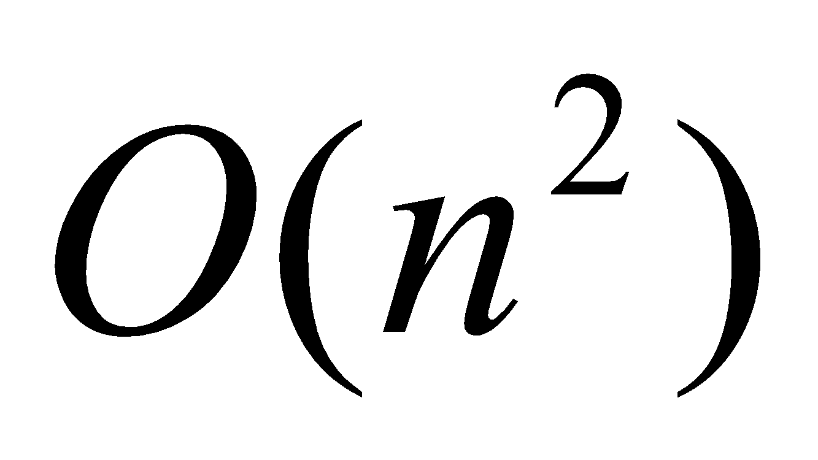
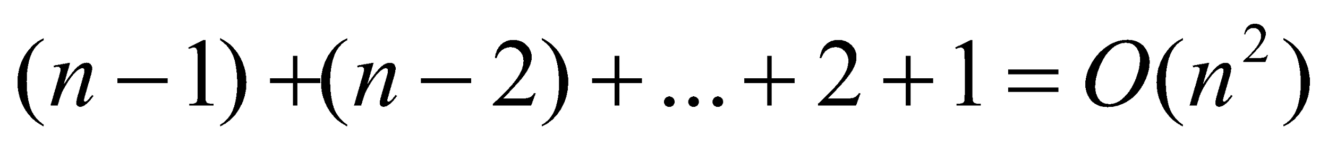
Worst-Case Time
In the worst case, each time the pivot divides the array into one big subarray with the other empty. The size of the big subarray is one less than the one before divided. The algorithm requires time:

Slide 123
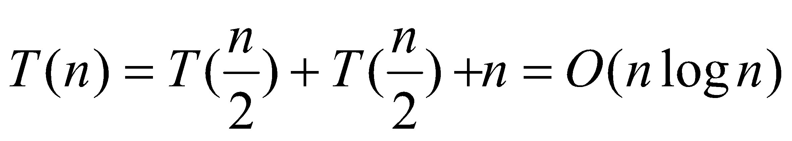
Best-Case Time
In the best case, each time the pivot divides the array into two parts of about the same size. Let T(n) denote the time required for sorting an array of elements using quick sort. So,

Slide 124
Heap Sort

Slide 125
Heapsort
Merge sort time is O(n log n)
But requires (temporarily) n extra storage items
Heapsort
Works in place: no additional storage
Offers same O(n log n) performance
Idea (not quite in-place):
Insert each element into a priority queue
Repeatedly remove from priority queue to array
Array slots go from 0 to n-1

Slide 126
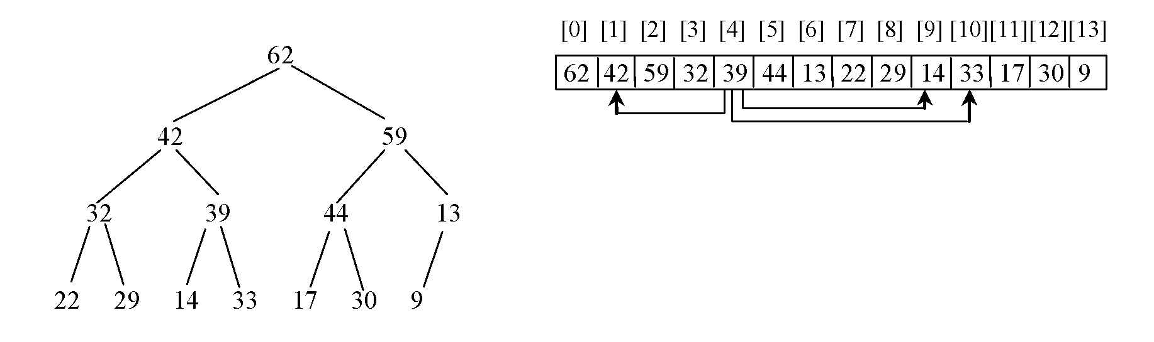
Heap Sort
Heap sort uses a binary heap to sort an array.
The index of the parent of the node at index i: (i – 1) / 2
Left child of index i: 2i+1
Right child of index i: 2i + 2

Slide 127
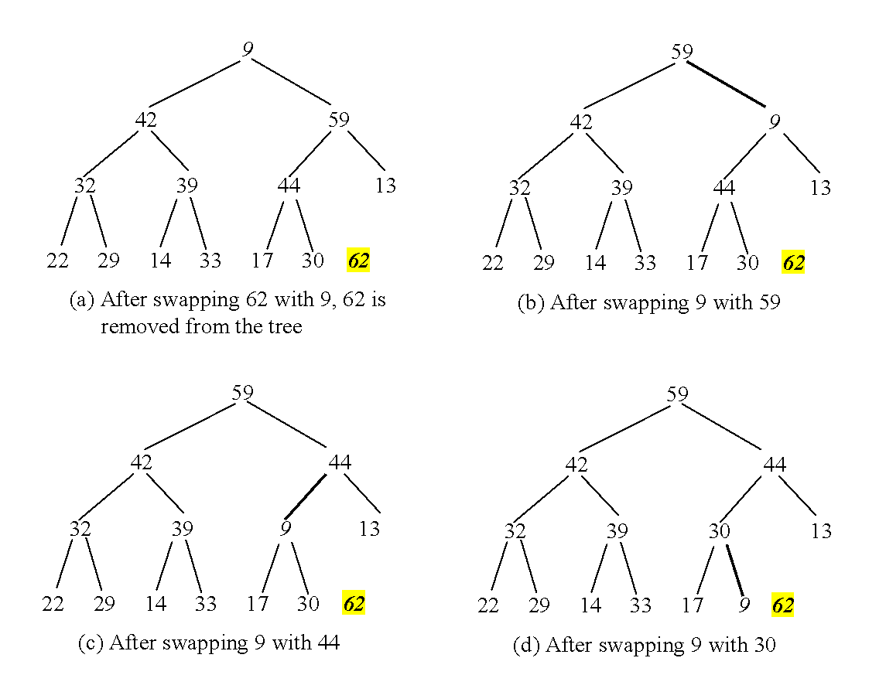
Heap Sort

Slide 128
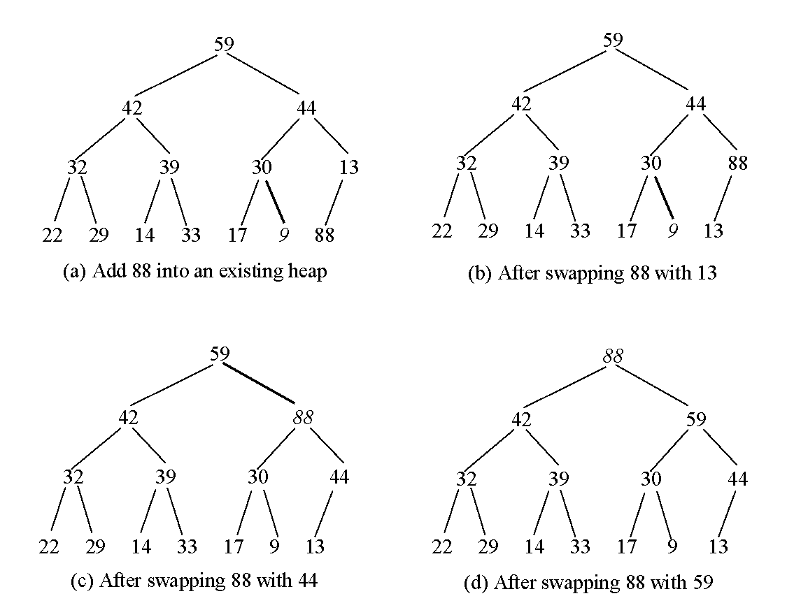
Creating an Initial Heap

Slide 129
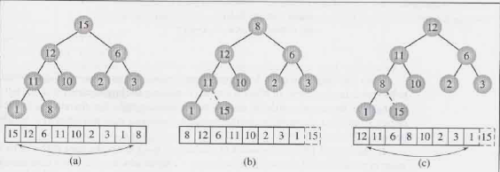
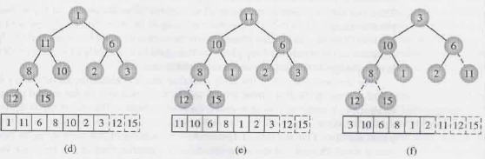

Slide 130
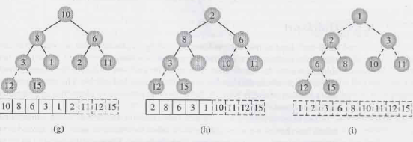

Slide 131
Average-Case Time
On the average, each time the pivot will not divide the array into two parts of the same size nor one empty part.
Statistically, the sizes of the two parts are very close.
So the average time is O(nlogn).
The exact average-case analysis is beyond the scope of this book.

Slide 132
Algorithm for In-Place Heapsort
Build a heap by arranging the elements in an unsorted array.
While the heap is not empty
Remove the first item from the heap by swapping it with the last item and restoring the heap property.

Slide 133
void heapsort(Object[] data)
{
for(int i=data.length/2-1; i>=0; --i)
moveDown(data,i,data.length-1);
for(int i=data.length-1; i>=1; i--)
{
swap(data,0,i);
moveDown(data,0,i-1);
}
}

Slide 134
Radix Sort

Slide 135
Radix Sort
Algorithm
sort by the least significant digit first (counting sort)
=> Numbers with the same digit go to same bin
reorder all the numbers: the numbers in bin 0 precede the numbers in bin 1, which precede the numbers in bin 2, and so on
sort by the next least significant digit
continue this process until the numbers have been sorted on all k digits
Notes:
‹#›

Slide 136

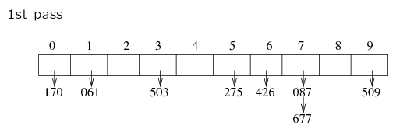
Radix Sort
Least-significant-digit-first
Example: 275, 087, 426, 061, 509, 170, 677, 503
170 061 503 275 426 087 677 509
Notes:
‹#›

Slide 137
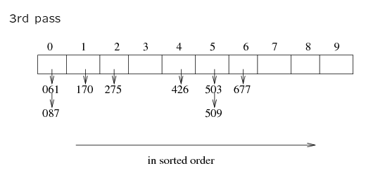
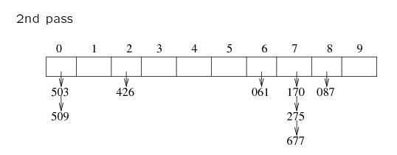
170 061 503 275 426 087 677 509
503 509 426 061 170 275 677 087
061 087 170 275 426 503 509 677
Notes:
‹#›

Slide 138
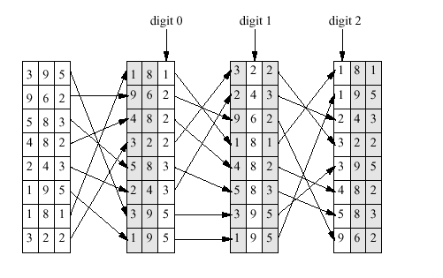
Sort by least significant digit instead of most significant digit.
Better than sorting by most significant digit since it saves
having to keep track of multiple sort jobs.

Slide 139
This is a non-comparison sort
This means that the sort does not compare array elements against each other
instead, use a collection of queues
peal off a digit/character of each item in the array
enqueue that array item into a queue matching the digit/character that we pealed off
once all array elements are inserted into their proper queues, dequeue each one at a time from each queue, placing the item back into the original array
repeat this process for each digit/character right-to-left

Slide 140
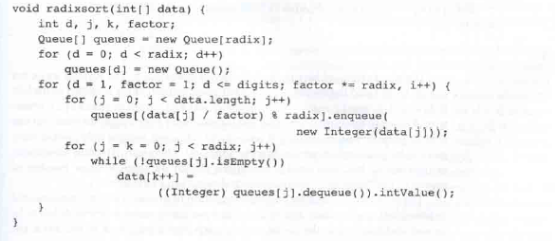

Slide 141
